Slide 1
MTN-025/HOPE
Off-Site Visit Procedures and
Documentation Considerations
Notes:
Outline:
Rationale for & overview of off-site visits
Review which procedures can occur off-site and what modifications can be made
Review study product considerations for off-site visits
Review documentation for off-site visits

Slide 2
Why have off-site visits in HOPE?

Slide 3
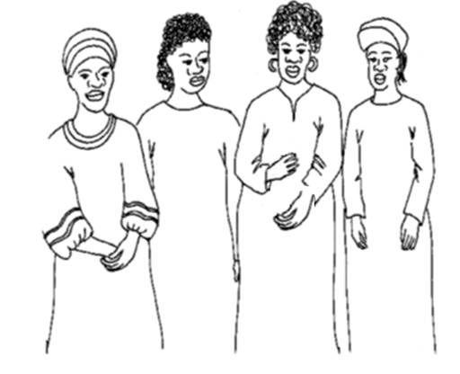
Why have off-site visits in HOPE?
Flexibility to support participants
Gaining input from those who decline full study participation (decliner group)
Notes:
Off site visits allow the flexibility to conduct a visit (or certain visit procedures—such as supplying more study product), even when a participant can not make it to the clinic.
You will find more detail on conducting off-site visits in SSP Section 6, participant follow-up

Slide 4
Overview of off-site visits
Off-site visits are not the same as outreach!
What are some differences between off-site visits and outreach?

Slide 5
Overview of off-site visits
Off-site visits are not the same as outreach!
What are some differences between off-site visits and outreach?
The purpose of the off-site visit is to conduct study procedures, while the purpose of outreach is to trace participants, and to inform & engage participants and the community
Off-site visits require informed consent while outreach requires permission
Notes:
Off-site visit procedures are also different from participant contacts made for the purposes of retention/tracing or to collect product in response to a product hold/discontinuation; these procedures are described separately in SSP Section 8 and Section 10, respectively.

Slide 6
Q&A: off-site visits
When should you use an off-site visit?
When has your site used off-site visits in the past?
Notes:
Potential examples:
Participant does not have time or is unable to come to the clinic for the visit
To conduct decliner population visit procedures (see SSP Section 2)
Follow-up on an adverse event/ serious adverse event
Collect samples that were inadequately collected or inadvertently missed at scheduled visits or compromised in transit to or at laboratory
Collect confirmatory HIV samples
Provide/collect study product
Follow-up on a participant who:
is unable to come to the clinic and may potentially fall outside of the visit window for the current visit
has voluntarily withdrawn from the study, but is willing to have a final HIV test/ pregnancy test/ safety bloods drawn off-site

Slide 7
Overview of off-site visits
When should you use an off-site visit?
When has your site used off-site visits in the past?
Off-site visits should be used for special circumstances, at IoR/designee discretion
Decliner Procedures
Notes:
Off-site visits should not occur for every single visit. Typically, visits should occur in the clinic, and we expect off-site to be used as an option when necessary, but hopefully infrequently (primarily due to staff time/resources they take, and also because not all procedures can be conducted off site). Site leadership should use good clinical judgment and discretion when determining that an off-site visit is needed for a particular participant.
It is strongly suggested that sites include the option of off-site visits for a defined set of reasons and procedures based on site capacity thus ensuring advance preparation to respond to adherence and/or retention issues.
However, we do foresee many of the decliner visits occurring off-site, since these participants may not be interested in visiting the clinic. We will go into more detail about off-site visits for decliners later in this presentation.

Slide 8
Procedures & Processes for Off-site Visits
Informed Consent
Permitted locations Participant home or other venues where participant & staff are comfortable, and where safety & confidentiality can be maintained
Permitted Visit Types
All follow-up visits and decliner
visits
Notes:
Off-site visit procedures (excluding site procedures for retention efforts and product collection due to product hold) may only be conducted if the participant has provided written consent to be visited by study staff outside of the clinic – except for the decliner population, who can give permission verbally via phone call to have informed consent conducted off-site.
During the administration of the informed consent for off-site visits, or requesting permission to conduct IC off-site for decliners, sites should discuss with participants any issues that may jeopardize participant confidentiality and/or safety, such as living situation (e.g., persons living with participant, availability of private space at participant’s home or place of work). Also, in an effort to minimize the potential risk of social harm to participants and to study staff who will conduct off-site visits, discuss with participants whether they have disclosed participation in the study to family, neighbors, or others who may learn of these off-site visits. Where participation has not been disclosed, maximal effort should be made to ensure inadvertent unwanted disclosure does not occur as a consequence of the off-site visit.

Slide 9
Procedures & Processes for Off-site Visits
Study Procedures
Procedures should be largely the same as an in-clinic visit
Some procedures may be modified or conducted only at the clinic because of limited ability to carry them out in an off-site visit (ACASI, pelvic & physical exams)
Document within participant records what occurs on or 0ff-site
Notes:
Site staff should document within participants records which visits were conducted off-site and what procedures were omitted or modified as a consequence (if any). As with any visit (in-clinic or off-site), participants have the right to decline/refuse completing any study procedures; site staff should clearly document refusals in the participant chart.
Effort should be made to finish required visit procedures that are not conducted during an off-site visit as part of a split visit within the visit window.

Slide 10
Off-site Visits for Decliners
Procedures for enrollment & completion of visit
Permission to conduct informed consent off-site can be given via phone call prior to the visit
Staff to document status of each eligibility criteria
Staff to confirm eligibility with IoR or designee via phone call
All procedures can be carried out with the enrolled participant
Upon return to the site, IoR or designee will provide final written verification of eligibility
Notes:
Permission to carry out informed consent procedures can be gained verbally on the phone call before the visit, and should be outlined within site SOPs.

Slide 11
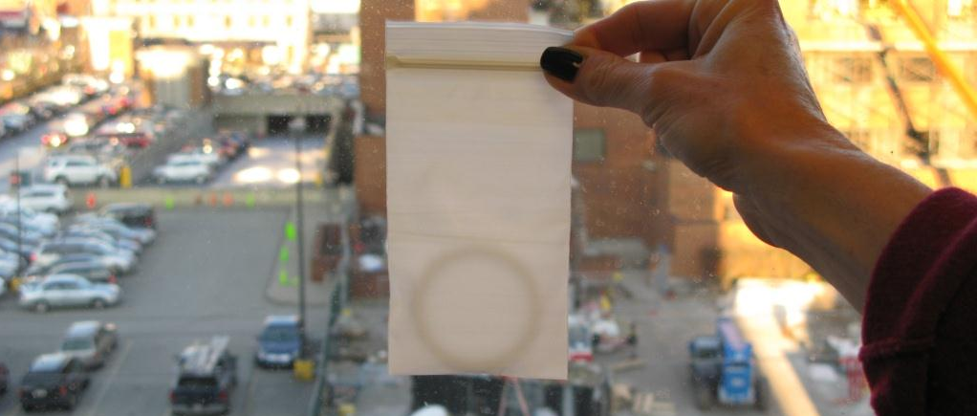
Minimum Procedures for Vaginal Ring Dispensation
The same as minimum procedures for VR dispensation within the clinic
Any further evaluations needed must be conducted prior to dispensing study product, and may require a follow-up clinic visit
Notes:
Follow the same procedures for vaginal ring dispensation in off- and on-site visits as discussed in the study product considerations session. If further procedures are needed, such as HIV or pregnancy testing, these must be carried out before VR is dispensed.
AE assessment and reporting (verbal report of symptoms is acceptable; if symptoms indicate that further evaluation is necessary, this must be conducted prior to dispensing study product)
HIV pre- and post-test counseling and pregnancy testing are required for product dispensation if this has not been done within the past 90 days.
Collection of Used Ring (and unused, if applicable), if available
As needed, HIV Prevention Options Counseling/Product Use Instructions

Slide 12
General Considerations
Verifying Consent
Safety/Confidentiality
Staffing
Managing symptoms/conditions requiring medical attention
Materials/Supplies Required
Notes:
The next few slides contain information that should be considered within site SOPs, such as:
Procedures for contacting and scheduling participants for off-site visits.
Procedures for verifying participants’ consent prior to conducting off-site visits.
Procedures to protect the safety of study staff, participants and any family members present during off-site visits, as well as confidentiality of participants.
Identification of staff member roles and responsibilities for off-site visits:
In general, most off-site visits will require two staff members, including one who is able to provide clinical assistance in case of symptoms or AEs, perform phlebotomy, conduct and verify rapid tests results and assist with specimen processing
Ensure that at a minimum one of these staff members are conversant in the language of choice of the participant
Ensure that these staff members are thoroughly versed in confidentiality and pharmacy and lab chain of custody issues
Procedures for management of symptoms/illness requiring medical attention. Specifically, procedures for management of positive pregnancy tests, positive or discordant HIV rapids, STI symptoms, contraceptive use and potential SAE/EAE, as well as provision of any necessary referrals should be described.
NOTE: If genital symptoms are reported during an off-site visit, the participant should be asked to report to the clinic as soon as possible for a pelvic exam.
Generally, if any issues requiring further follow-up arise at an off-site visit, the participant should be referred (or brought) to the clinic as soon as possible for further evaluation. Depending on the severity of the issue, site staff may need to transport participant immediately from the off-site visit to the clinic or nearest healthcare facility.
Description of how routine participant identification procedures will be modified for off-site visits.
List of materials and supplies that will be needed for an off-site visit.

Slide 13
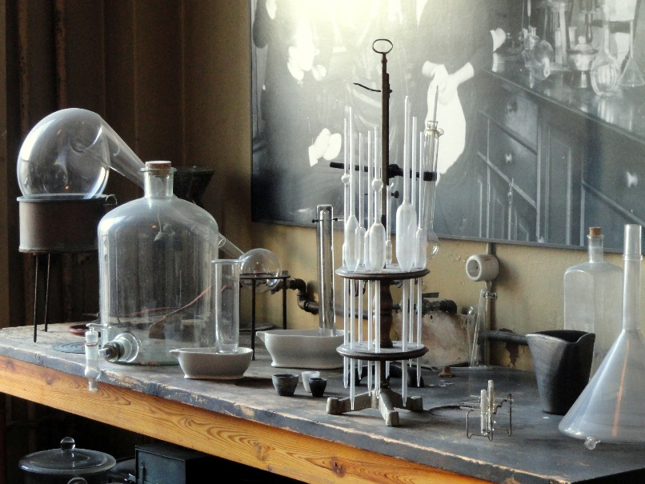
Lab Considerations
Chain of custody for specimen transport
Specimen handling/transport
Safety (biological specimens, bio-waste)
Testing timeframes
Equipment and supplies
Staffing
Source Documentation
Notes:
Considerations for collection of specimens for transport to an outsourced and on-site laboratory:
Chain of custody, for specimens to be transported from off-site visits
Safety considerations, including details on how biological specimens and bio-waste will be handled and procedures to prevent and respond to specimen accidents
Adhering to allowable time intervals to get specimens to testing laboratories
Specimen handling and transport methods
Equipment and supplies
Considerations for testing performed in an off-site location:
Source documentation for test results
Staffing: 2 staff members qualified in HIV rapid testing will be required to perform and review HIV testing results (if performing finger sticks).
Safety considerations, including details on how biological specimens and bio-waste will be handled and procedures to prevent and respond to specimen accidents
Equipment and supplies
Appropriate area in off-site location to perform testing
NOTE: Staff should follow the same procedures specified in SSP section 12 and site-specific SOPs in the event of a possible seroconversion (i.e. a positive rapid HIV test) identified during an off-site visit. If possible and agreed upon by the participant, sites should offer immediate transport to clinic for directed post-test counseling and sample collection for seroconversion.

Slide 14
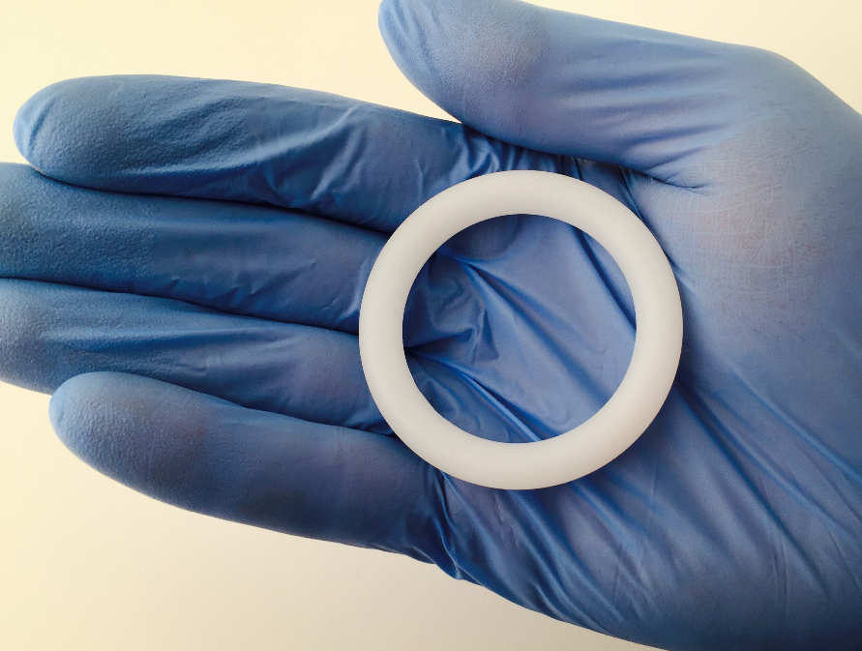
Study Product Considerations
Requests for VR in advance
Chain of custody
Transport conditions/temperature
Procedures in the event study product is not delivered
Collection and transport of used/unused VR
Documentation
Notes:
Please follow MTN-025 SSP 09, Study Product Considerations, for specifications on product supply procedures for off-site visits.
Requesting participant-specific study product from the pharmacy prior to the off-site visit
Ensuring proper chain of custody of participant-specific study product from time of receipt from the pharmacy to time of delivery to the participant, including ensuring that participant-specific study product is delivered to the correct participant
Transporting participant-specific study product at appropriate temperatures from time of receipt to time of delivery to the participant
Handling/returning participant-specific study product when the participant cannot be located or refuses to receive the product dispensed for her.
Handling of used and unused study product, including procedures for collection and transportation back to clinic.
Documenting all of the above, and appropriately storing all documentation in either the study clinic and/or pharmacy (as per site SOP).

Slide 15
Source Documentation Considerations
No completed CRFs or other source documents should leave clinic – including any equipment used for Medidata entry
Blank CRFs and staff notes summarizing source documents may be taken
Notes:
No completed CRFs or other source documents should leave the study clinic. Blank CRFs and staff notes (summarizing source documents in the binder) needed to conduct the visit may be taken off-site. Rather than carry laptops or tablets for eCRF entry, site staff should travel with blank paper CRFs and enter them upon return to the site.
Visit notes may be necessary to follow up on AEs/symptoms/contraceptive use documented at the last visit (system for this should be outlined in the site off-site SOP)
Source Documentation and Data Management SOPs apply to off-site visit documentation and data collection/management just as they do for on-site visits

Slide 16
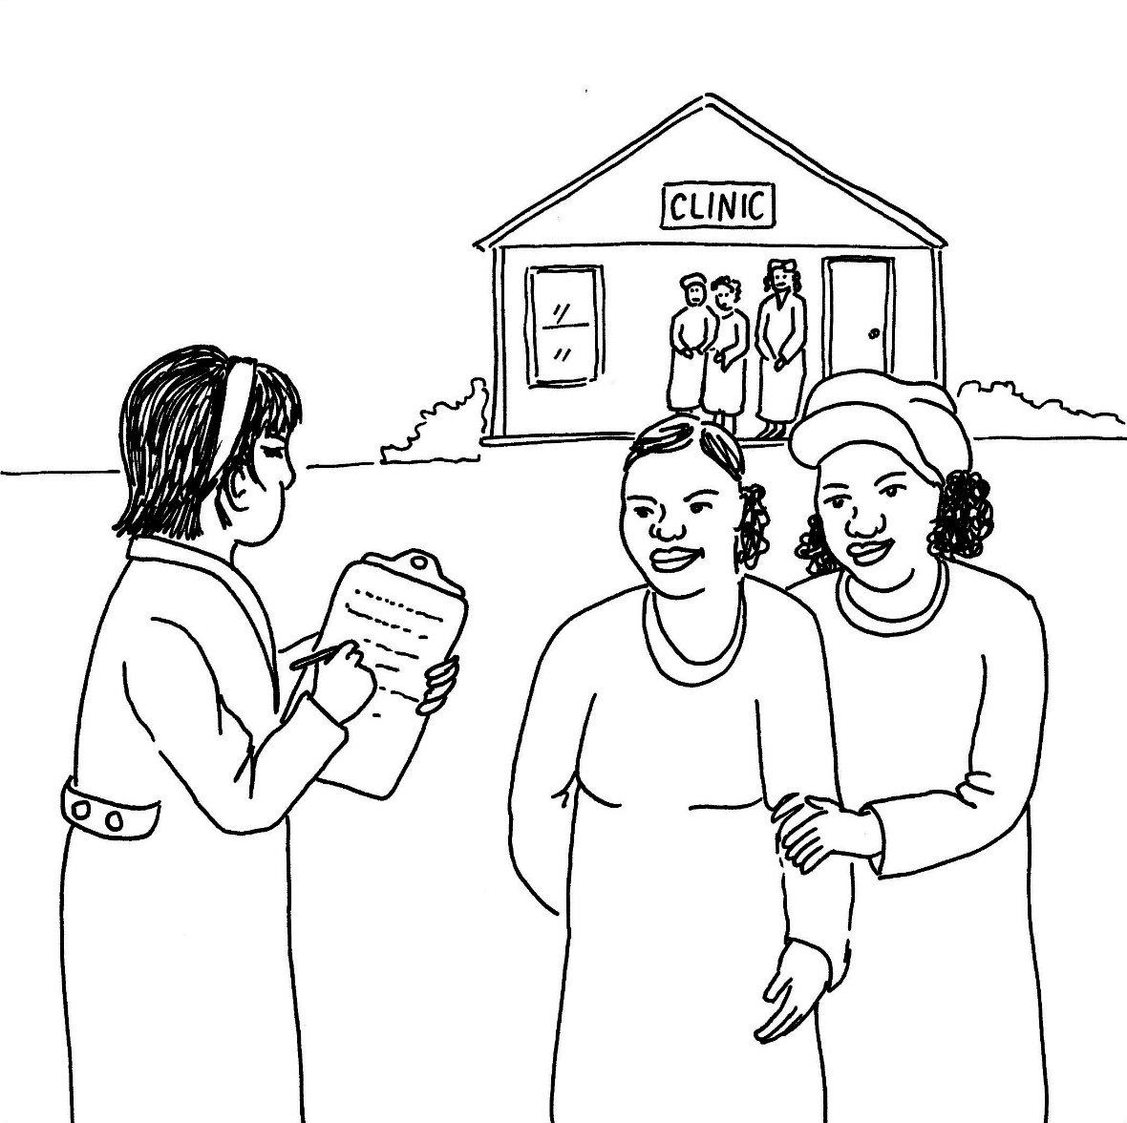
Any questions?

